Slide 1



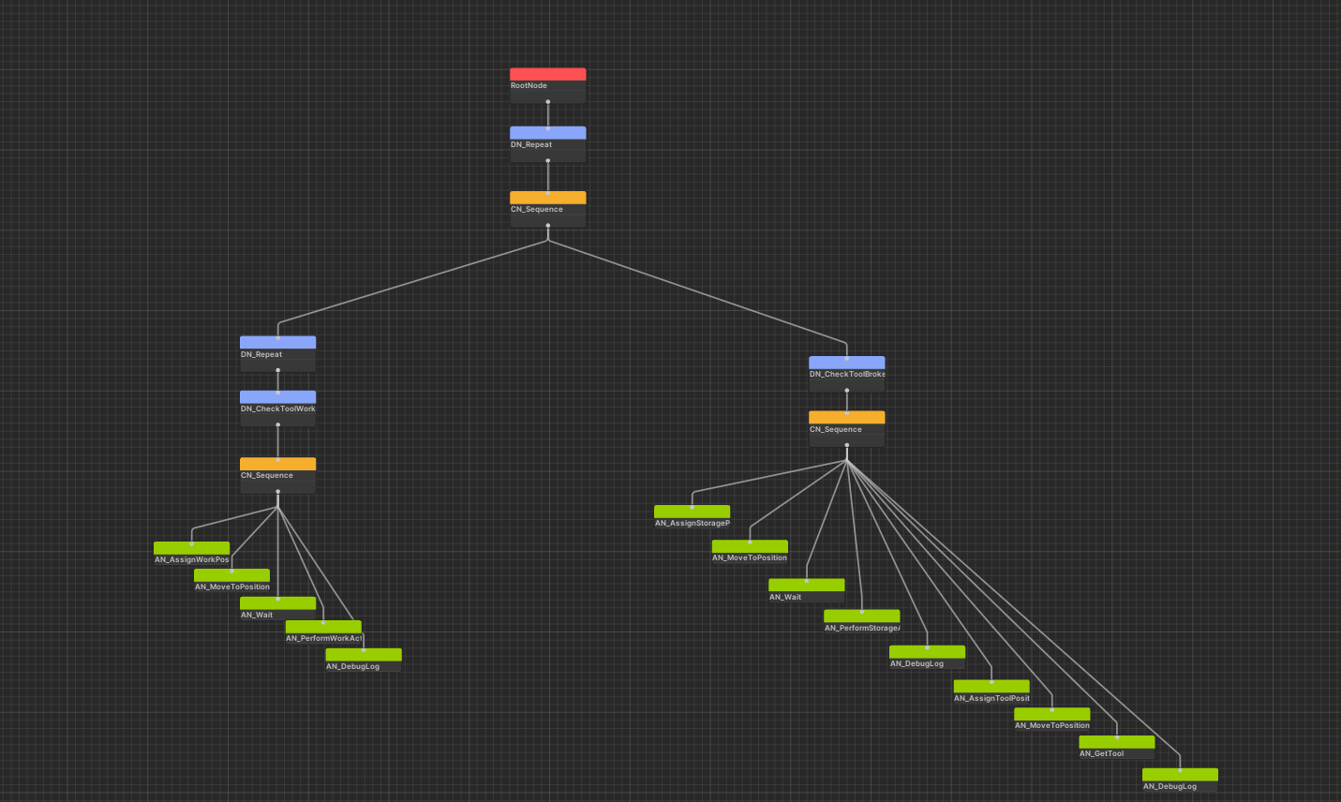
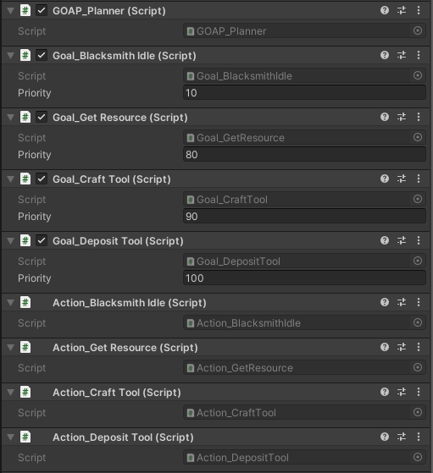
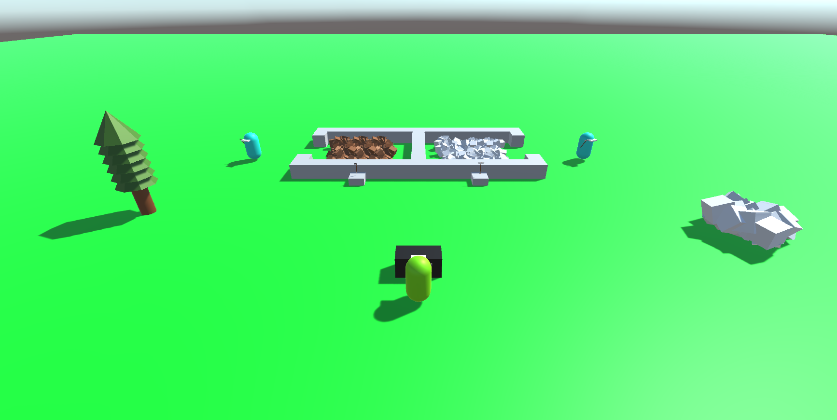
Behaviour
Trees
VS
GOAP
Overview
Features
The aim of this project is to compare the use of Behaviour Trees and Goal-Oriented Action Planning in the creation of videogame A.I. NPCs (Non-Player Characters).
In the end two scenarios were made in Unity with the help of pro builder to build out simple scene assets that simulated 3 NPCs simulating workers performing different jobs.
It is very difficult to find a fair comparison between the two methods as games can vary wildly from each other.
The first 2 NPCs are the miner and the lumberjack that harvest resources until their tools break then deposit the resources at the storage and get a new tool from their station if there is one.
The project will try to provide a fair comparison by creating two identical scenarios in the Unity game engine with the only difference between them being the NPCs in those scenarios being made with the two methods.
The last NPC is the Blacksmith which takes the resources deposited in the storage, craft new tools with these resources and deposits them at the other NPCs stations when they are empty.
Technologies
Behaviour Trees
GOAP
Behaviour Trees use a hierarchy of nodes that get executed from left-to-right and top-to-bottom that start from a root node and expand downwards that when visualised resemble the roots of a tree. A custom Behaviour Tree editor was made in the project to be able to make and visualise the Behaviour Trees inside Unity. Below is an image of the Behaviour Tree used by the Lumberjack and Miner NPCs in the project inside the Behaviour Tree editor.
Goal-Oriented Action Planning also known as GOAP allows NPCs to given a set of actions and goals that get sorted via a planner for the NPC to figure the goals it wants to do and what action it wants to perform to fulfil that goal making the NPCs made with GOAP a act very unpredictably and simulate intelligence. Below is the GOAP planner, goals and actions for the Blacksmith NPC.
Scene Layout
Here is the layout of one of the scenes. Both Scenes are the same with the only difference being the NPC logic and the positioning of assets.
Each Scene contains one of each A.I. NPC, a flat green plane for the ground, a storage that has a wood, iron deposit and two tool stations attached to it. There is a tree and a iron deposit in the word for the harvesting NPCs to do their work and anvil for the Blacksmith to craft tools.

